Slide 1
CSE 4128
Lab 5
Morphological Image Processing
Hit-or-Miss Transformation
Dr. Sk. Md. Masudul Ahsan
Professor,
Dept. of Computer Science and Engineering,
KUET
Dipannita Biswas
Lecturer,
Dept. of Computer Science and Engineering,
KUET
Kaniz Fatema Isha
Lecturer,
Dept. of Computer Science and Engineering,
KUET

Slide 2
Basic Operations
erosion = cv2.erode(img, kernel, iterations = 1)
dilation = cv2.dilate(img, kernel, iterations = 1)
opening = cv2.morphologyEx(img, cv2.MORPH_OPEN, kernel)
closing = cv2.morphologyEx(img, cv2.MORPH_CLOSE, kernel)
Bitwise Operations:
bitwiseAnd = cv2.bitwise_and(img1,img2)
bitwiseOr = cv2.bitwise_or(img1,img2)
bitwiseNot = cv2.bitwise_not(img1)

Slide 3
Structuring Element
1. cv2.getStructuringElement(cv2.MORPH_CROSS,(5,5))
2.array([
[0, 0, 1, 0, 0],
[0, 0, 1, 0, 0],
[1, 1, 1, 1, 1],
[0, 0, 1, 0, 0],
[0, 0, 1, 0, 0]], dtype=uint8)

Slide 4
The Hit-or-Miss Transform
If the background and the foreground in the structuring element match exactly the background and foreground pixels in the image, the the center of the structuring element is set to foreground color.
Take 2 structuring elements, B={B₁,B₂}.
Apply A B = (A Ɵ B₁ ) ∩ (A^{C} Ɵ B₂)
Here , B₁ = X, B₂ = W-X
*

Slide 5




The Hit-or-Miss Transform
X
X
X
W
W
W
W-X
Set A
Set A

Slide 6



The Hit-or-Miss Transform
A Ɵ X
A^{C} Ɵ (W-X)
(A Ɵ B₁ ) ∩ (A^{C} Ɵ B₂)
Final Output

Slide 7





X
Set A
W

Slide 8
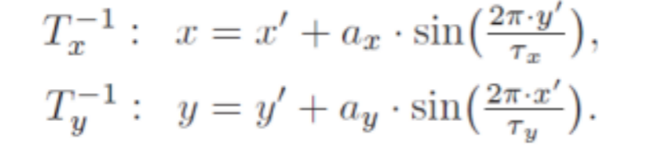
Assignment
Ripple:
In this case the inverse transformation of a target point x ′ = (x ′ , y′ ) is:
Here, parameter a_{x}, a_{y} specifies the distortion’s amplitude along the x and y axis and τ_{x}, τ_{y} are the wavelengths (measured in pixel units) along the x and y axis.

Slide 9
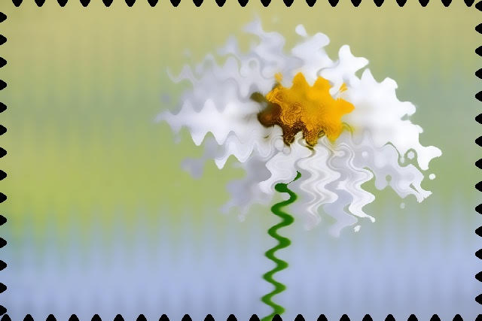


Ripple:
a_{x} = a_{y}=10
𝜏_{x} = 𝜏_{y} =50
a_{x} = 7 a_{y}=10
𝜏_{x} = 30 𝜏_{y} =50
Input

Slide 10

Assignment
Tapestry:
In this case the inverse transformation of a target point x ′ = (x ′ , y′ ) is:
Here, center point x_{c} = (x_{c} , y_{c} ). Parameter a specifies the distortion’s amplitude and τ_{x}, τ_{y} are the wavelengths (measured in pixel units) along the x and y axis.

Slide 11

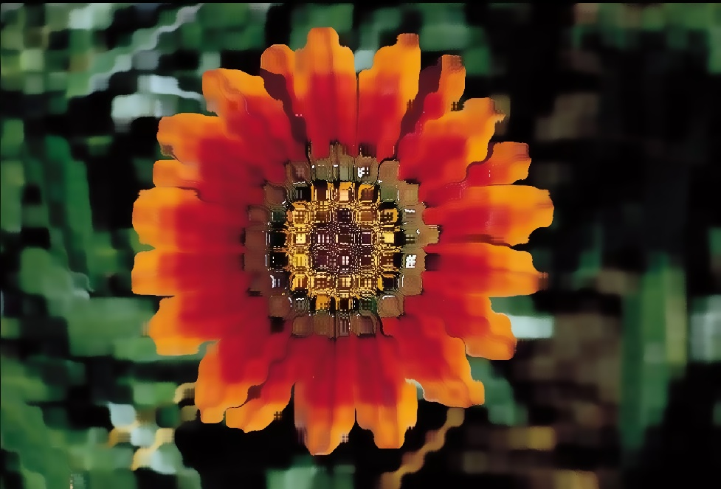
Tapestry:
Input
Output
a = 5, 𝜏_{x} = 𝜏_{y} =30

